Slide 1
Databases and the Web IS53064A
Lecture 2.1
Data Security

Slide 2
Securing Data in Storage

Slide 3
Two aspects to data security
Data in storage
Data in transit
Today we will look at data in storage

Slide 4

Threats
What are the threats to data?
Hackers
Disgruntled employees
Careless employees
Industrial espionage
Terrorism
Natural disasters
Hardware failure
Power failure
Data leakage

Slide 5
Risks
The threats will map to these risks:
Data getting lost
Data getting corrupt
Data getting into the wrong hands

Slide 6


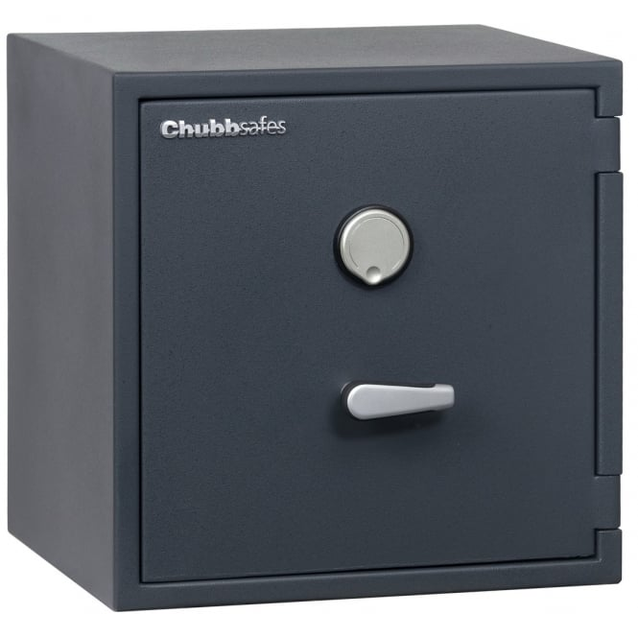
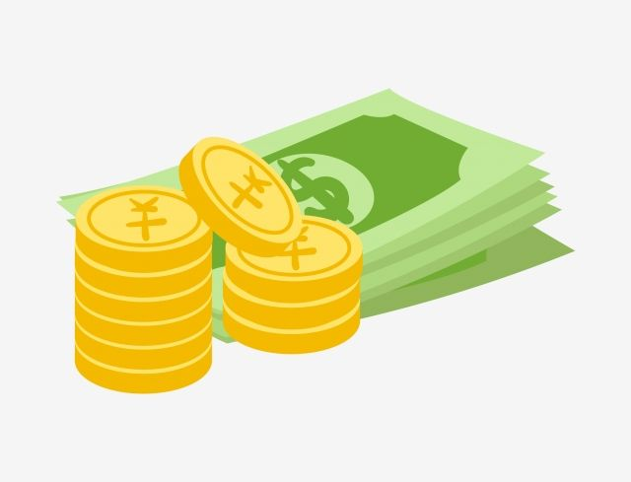
How can we protect against these?
General approach
Know everywhere data is stored
Identify points of weakness or potential failure (security risks)
Implement mechanisms to limit each security risk
Best to implement multiple lines of defence

Slide 7

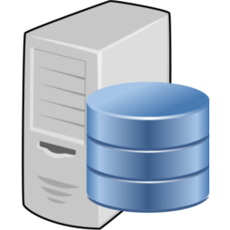

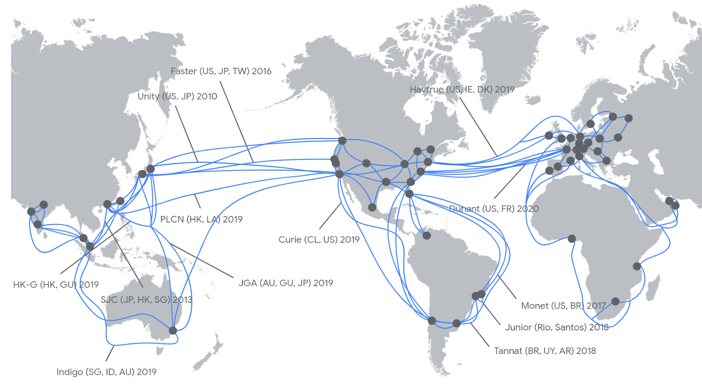


Know where data is
Might be harder than you think!
Many systems are highly distributed
Offline storage
Globally Distributed Systems
Database Servers
Web Servers
USB sticks
Developer machines

Slide 8
Data classification
Level of security needs to be appropriate. Organisations will generally classify their data:
Sensitivity
Public: Data is intended for public use.
Internal: Data is intended for internal company use.
Confidential: Data is intended for specific individuals only.
(other terms sometimes used: controlled, classified, restricted, etc)
Ownership
Which organisation or individual owns the data? Or is it publicly owned?

Slide 9
Data classification
PII (Personally Identifiable Information)
Name
Date of birth
Phone no
Email
National insurance number
Bank account details
Passport no
etc
Risks:
Identity theft
Hackers
Personal financial loss
This type of data needs to be handled with particular care!
There are regulatory requirements around this.

Slide 10

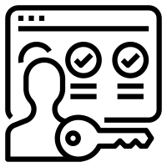






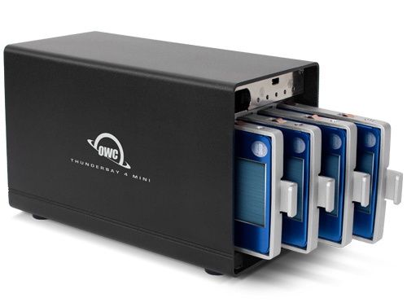


How can we protect against risks?
Access control
Separation of duties
Physical security
Regularly apply security patches and updates
Encryption
Have a disaster recovery plan
Redundancy
Backup

Slide 11
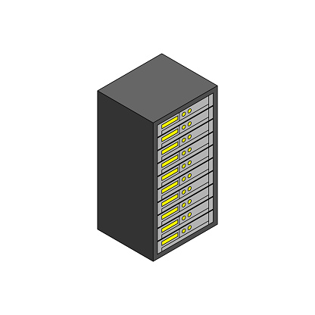





Who is responsible?
Every organisation and individual handling the data
Web Hoster
Developer
Data Centre
Database Administrator
Organisational Security Team
Network Administrator

Slide 12
Database Administrator
Key role responsible for
Security of data
Integrity of data
Design and development
Maintenance procedures
Access control
Backup and recovery
Disaster recover planning / implementing
Patching and updating
Performance tuning
Deployment
Hardware/software evaluation and installation

Slide 13
Legislation – GDPR (EU)
Legal basis for processing
Organisation must have user’s unambiguous and explicit consent.
The right to be forgotten
Organisation must delete date on user’s request.
The right to access
Organization must supply users with a copy of all the data you have collected from them on request.
The right to rectification
Organization must correct any data that a user feels are inaccurate or complete data that a user feels is incomplete.
The right to data portability
Organization must transfer the data you have from a user to another organization or the user, under certain circumstances.
https://gdpr.eu/what-does-it-stand-for/

Slide 14
Legislation – HIPAA (US)
Protects sensitive health data (PHI)
General rules – organisations must
Ensure the confidentiality, integrity, and availability of all e-PHI they create, receive, maintain or transmit;
Identify and protect against reasonably anticipated threats to the security or integrity of the information;
Protect against reasonably anticipated, impermissible uses or disclosures; and
Ensure compliance by their workforce.
https://www.hhs.gov/hipaa/for-professionals/security/laws-regulations/index.html

Slide 15


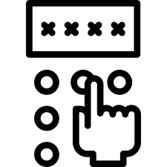


Access Control Identity and Access Management (IAM)
Authentication
Verify the identity of a user
Are they who they say they are?
Authorisation
Verify someone has permissions to access something
Should they be allowed to do X?
Often implemented through roles (role-based access)
Admin
Student
Lecturer

Slide 16
End of slides

